Slide 1
Traffic Ticket Management
IST 659-Database Management Systems
Pranay Lulla
April 16,2018

Slide 2
Project Goals
Driver’s Ticket Details are collected.
Court details are collected and assigned to ticket
Officer’s details are assigned to ticket
Number of Tickets on a License Number
All tickets on a License Number
Insert/Update/Delete all records

Slide 3
Who can input the data
Admin
Driver- Just to add tickets
Who Can Query the data
Admin
Driver

Slide 4
Project Goals
Major Data Questions
Find Ticket Details using Ticket Number
Find Court and Offence Details using Ticket Number
Number of Tickets on License Number
Find all the tickets and their details using license number
Find the court to edit by selecting court_id
Add/Delete Drivers

Slide 5
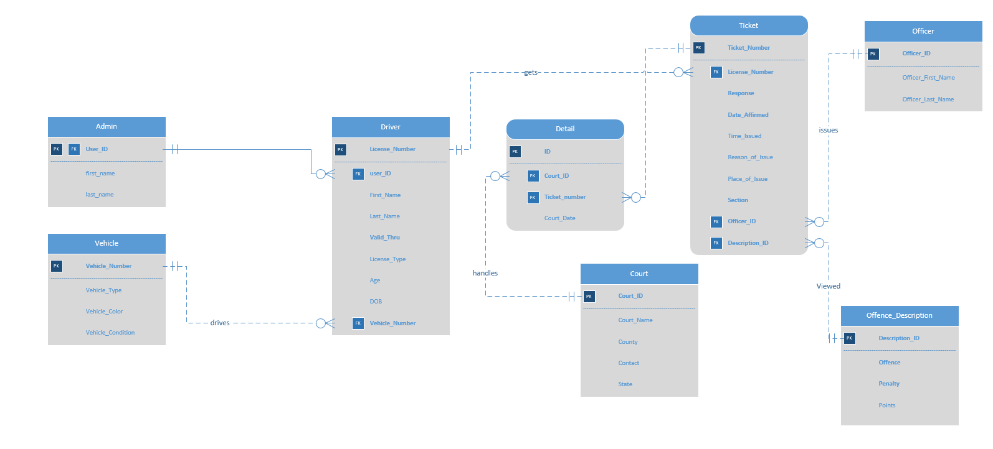
ER Diagram - Visio

Slide 6
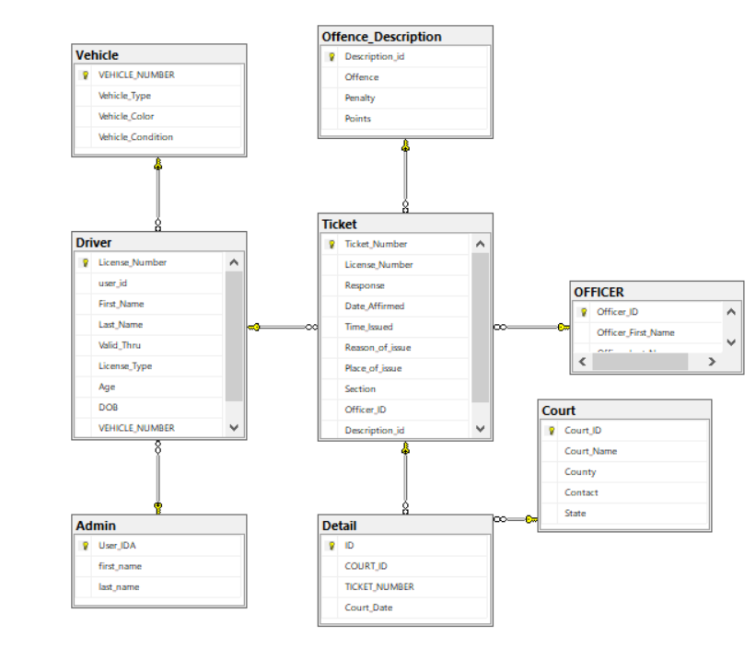
ER Diagram - SQL

Slide 7
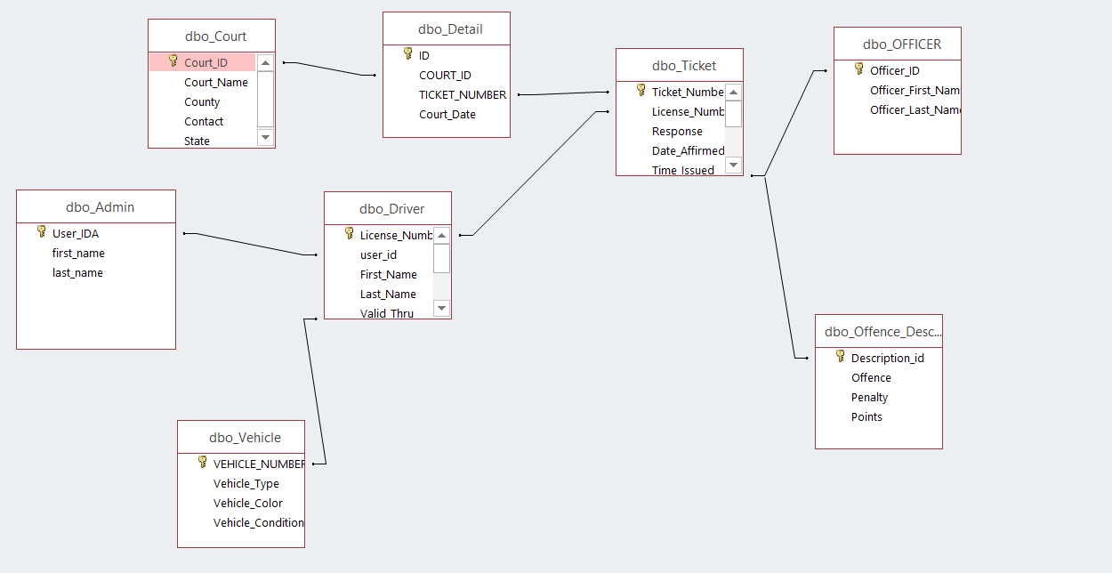
ER Diagram - Access

Slide 8
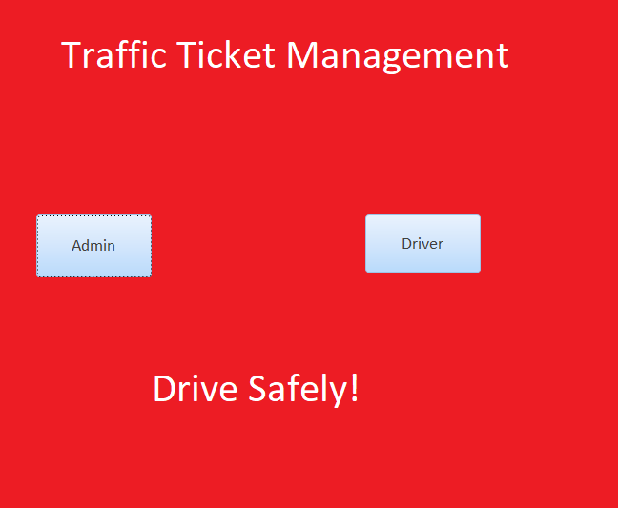
Forms

Slide 9
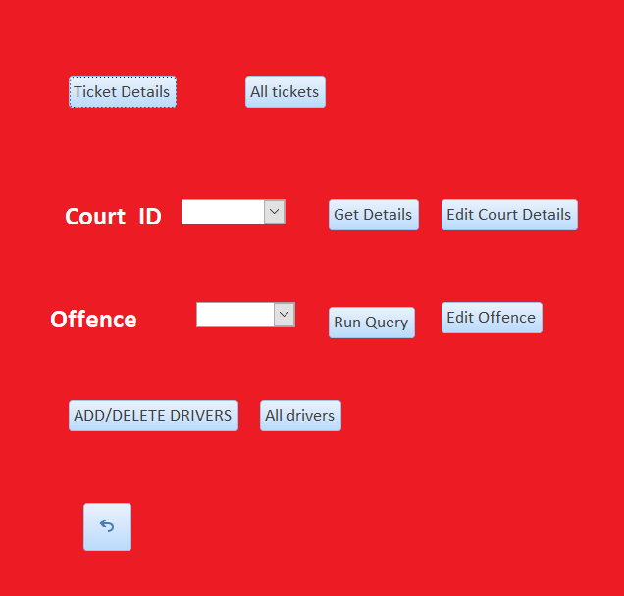
On Click - Admin

Slide 10
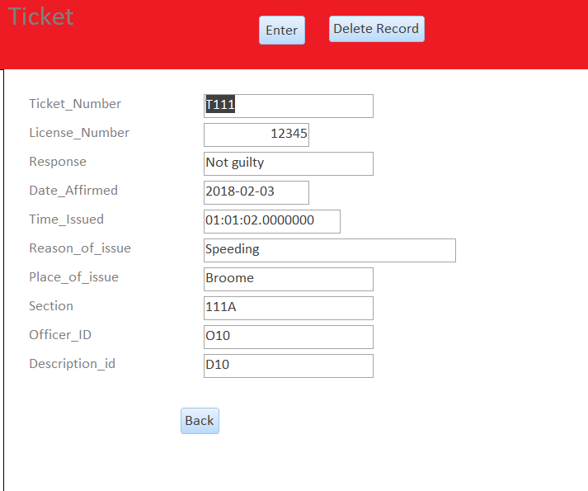
On Click Ticket Details Form Wizard With All Records

Slide 11
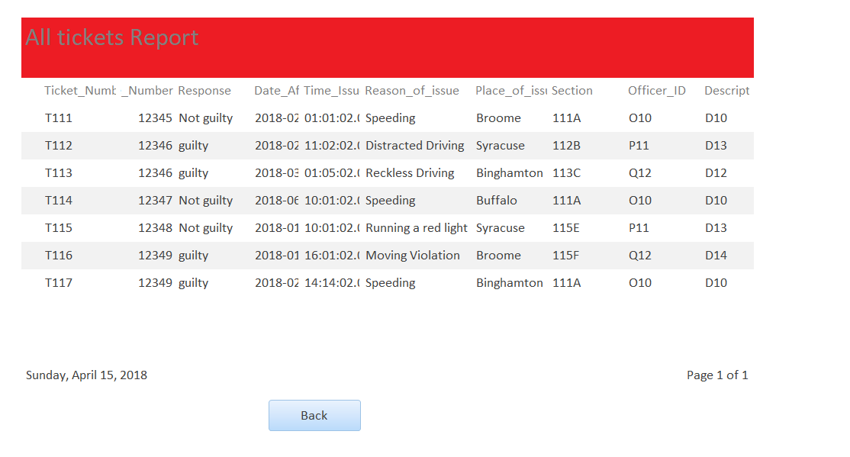
All Tickets-Admin

Slide 12
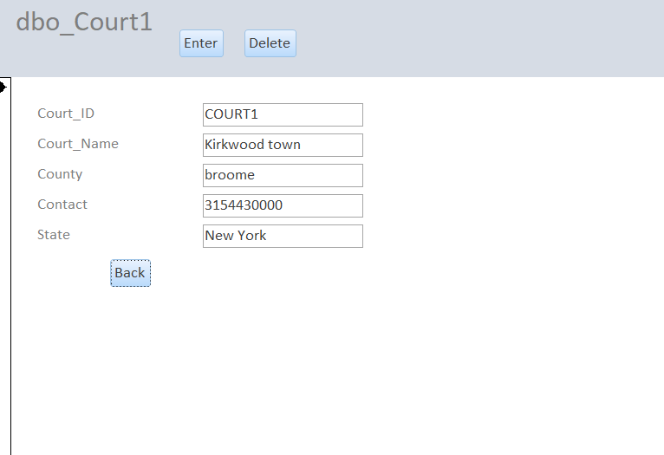
Edit Court Details(Form Wizard)-Admin

Slide 13
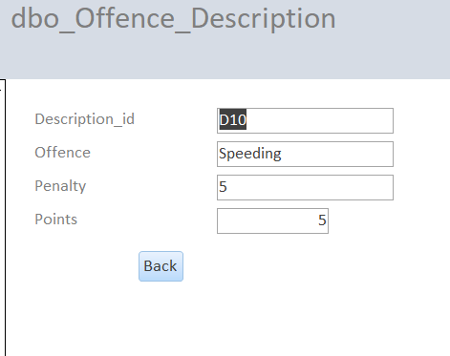
Edit Offence Details(Wizard)-Admin

Slide 14
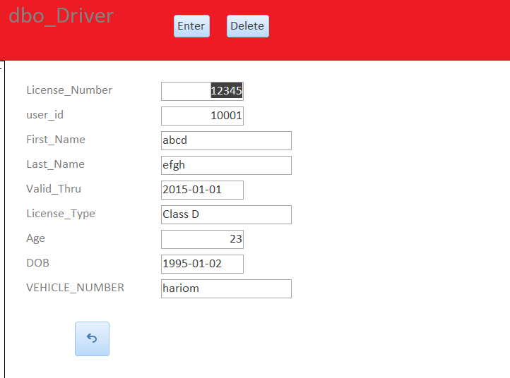
Add/Delete Drivers-Admin

Slide 15
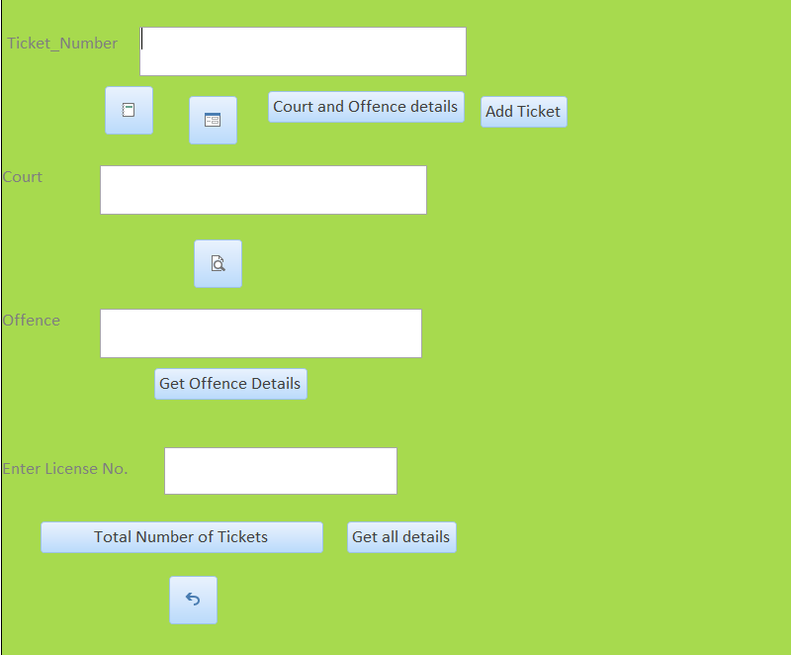
Driver Access

Slide 16
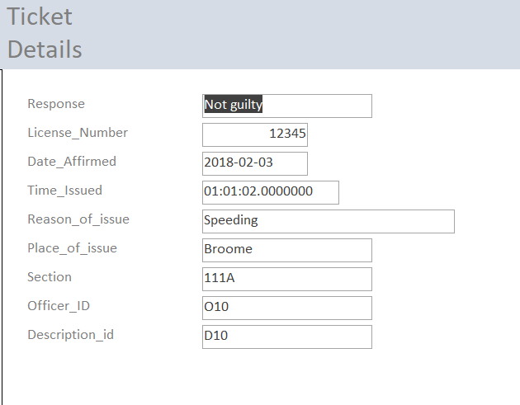
Ticket Details By Ticket Number- Driver

Slide 17
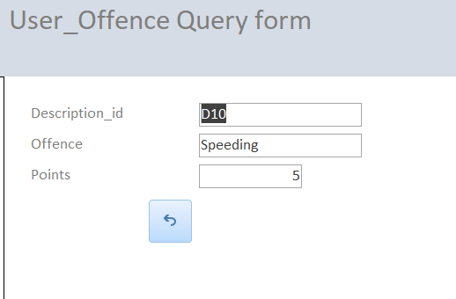
Offence Details by ID-Driver

Slide 18
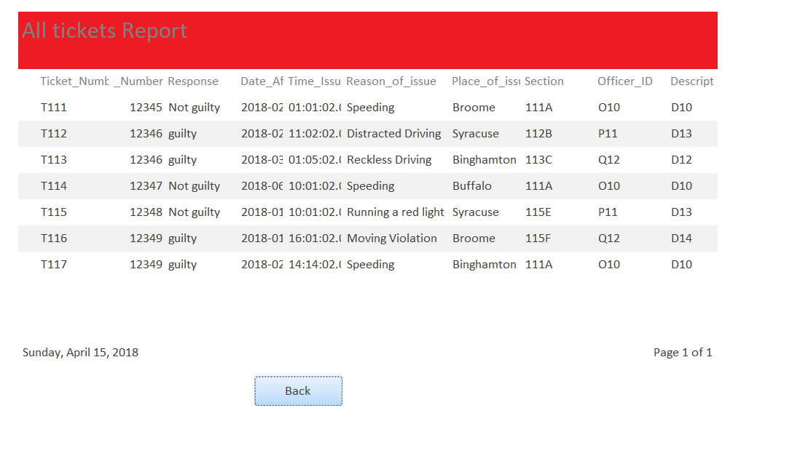
Reports-Admin

Slide 19
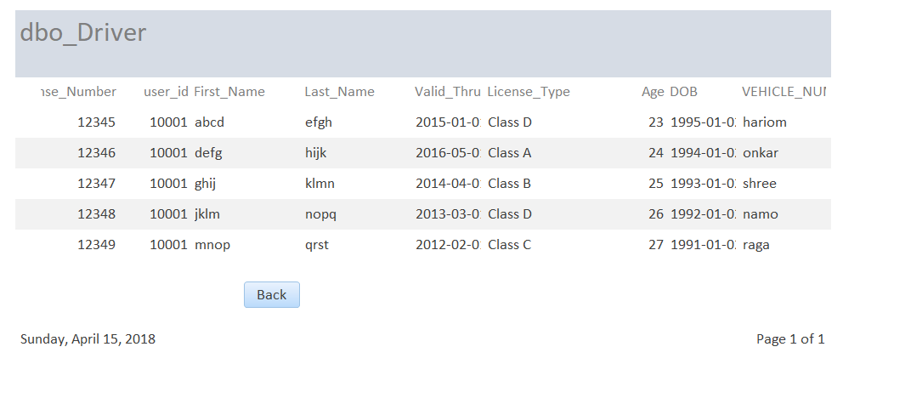
All Drivers-Admin

Slide 20
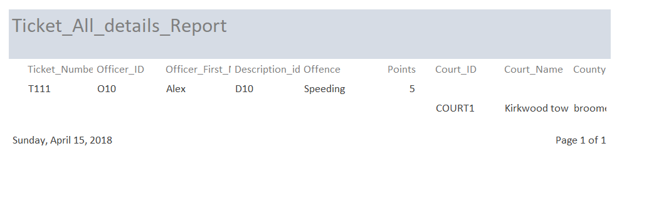
Reports-Driver Court and Offence Details by Ticket Number

Slide 21
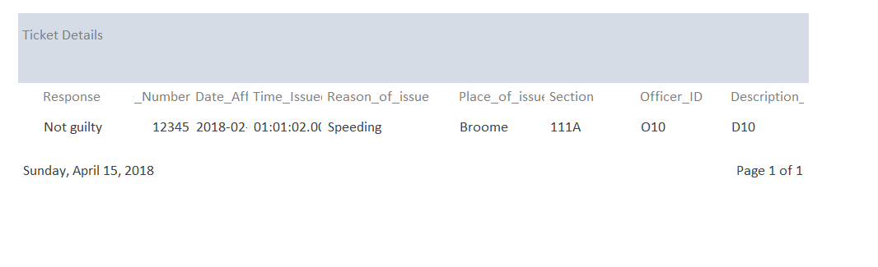
Ticket Details by Ticket Number

Slide 22
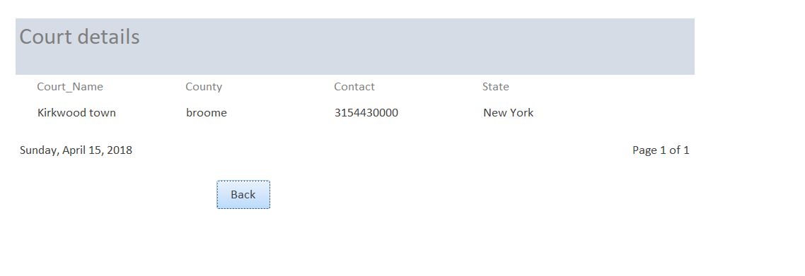
Court details by Ticket Number

Slide 23
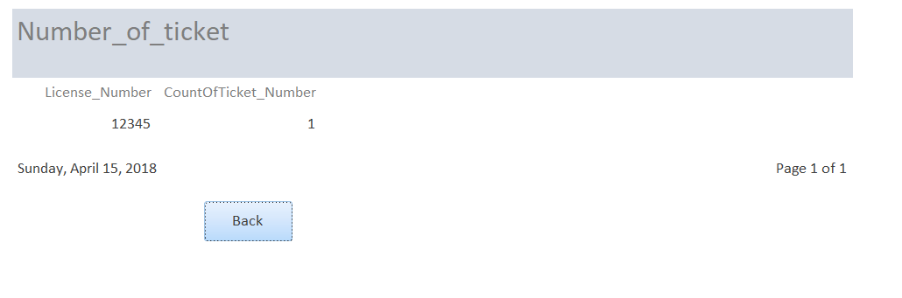
Total Number of Tickets

Slide 24
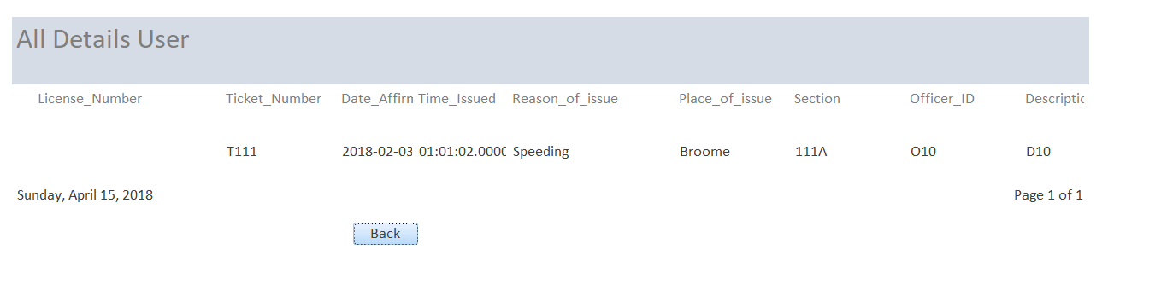
All Ticket by License Number

